Slide 1
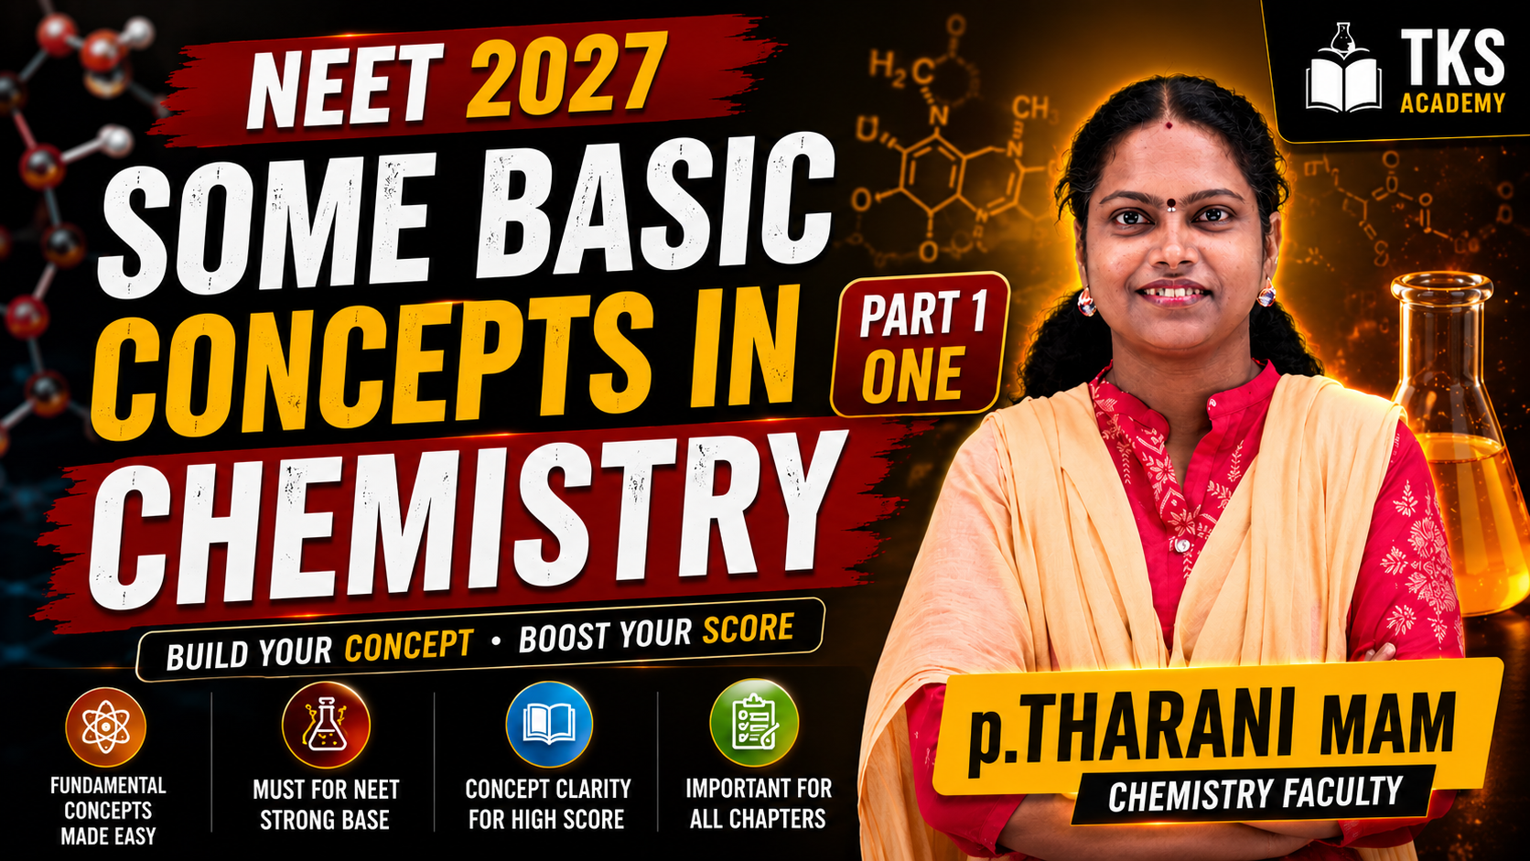

Slide 2


Some basic concept in chemistry

Slide 3
Introduction :
The word ‘Stoichiometry’ is derived from Two Greek words .
Stoicheion (meaning element)
Metron (meaning measure).
This chapter is useful to describe the physical properties of matter quantitatively by using numerical values with suitable units.

Slide 4
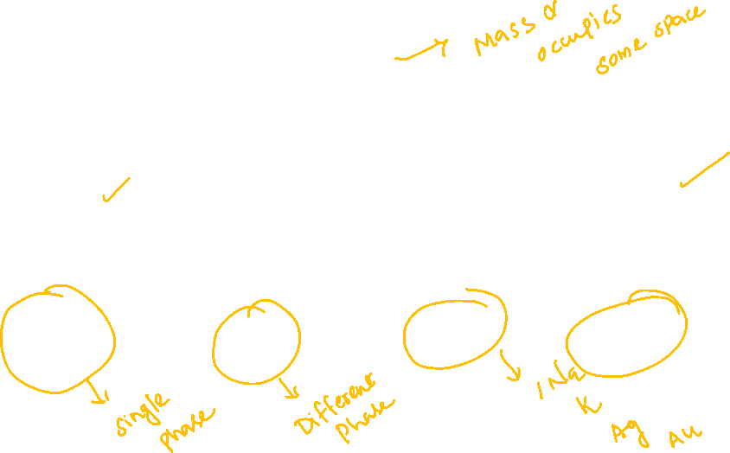
Matter
Mixtures
Pure substances
Homogeneous mixtures
Heterogeneous mixtures
Elements
Compound

Slide 5
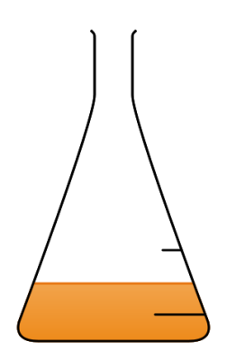
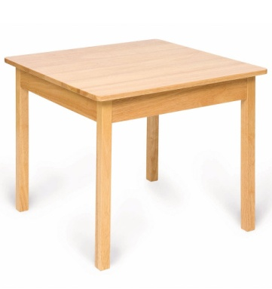
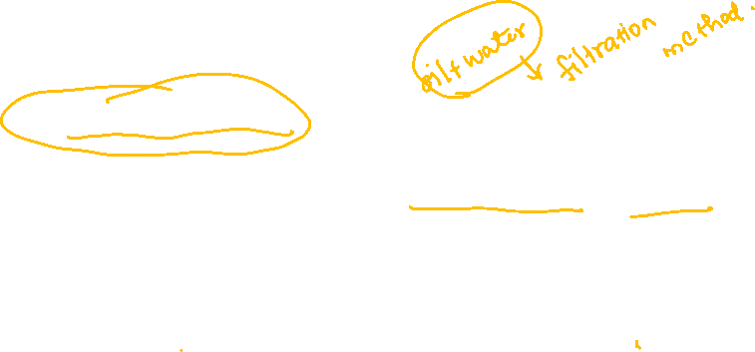
Matter :
Matter is anything that has mass and occupies some space.
Mixtures :
Variable composition
Components retain their characteristic properties
May be separated into pure substances by physical methods.
Mixtures of different composition may have widely different properties.

Slide 6
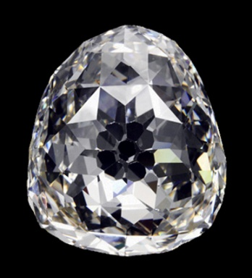
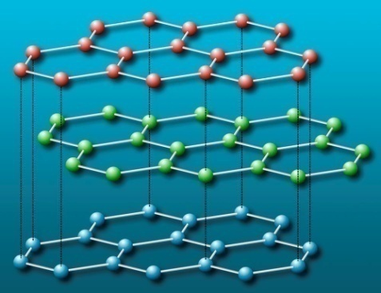
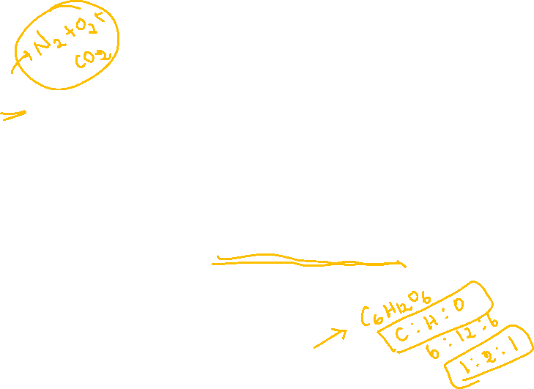
Eg: air, milk , gasoline, etc.
Pure substances :
Fixed composition
Cannot be separated by simple physical methods.
Properties do not vary
Eg: diamond,
graphite,
Glucose
Fixed composition of C, H, O in Glucose

Slide 7

Pure substances are further classified into
1) Elements and 2) Compounds
Elements :
An element consists of only one type of atom.
Cannot be decomposed further into simpler substances
Eg: Na, H, Cu, O, Ag

Slide 8
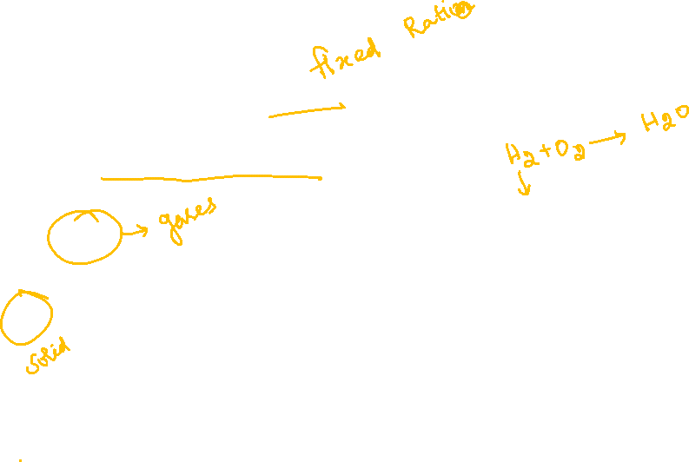
Compounds :
Contain two or more elements in a definite proportion by mass
Constituent elements do not retain their properties
E.g.
H₂O
CO₂
NH₃
2H
1O
1C
2O
1N
3H

Slide 9
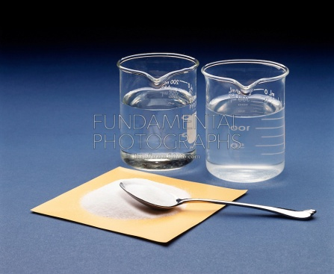
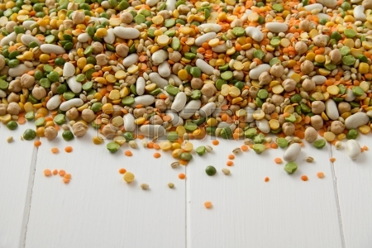
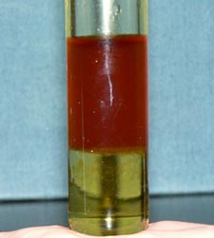
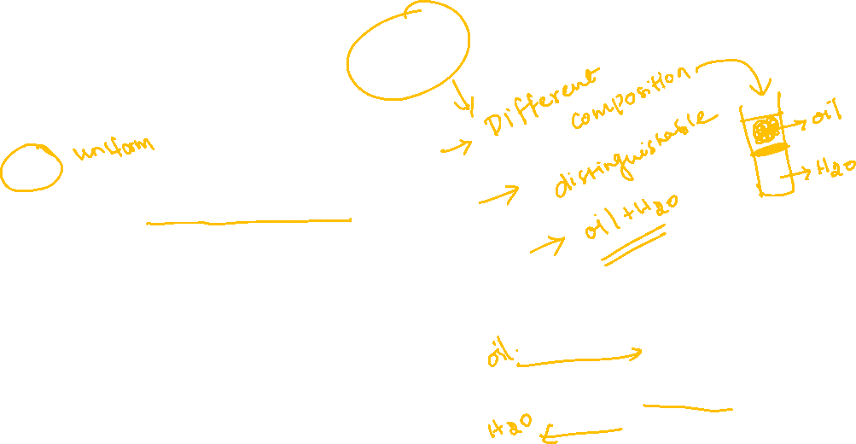
Mixtures further classified into two types
1) Homogeneous mixtures 2) Heterogeneous mixtures
Homogeneous mixtures
Have same composition throughout
Components are indistinguishable.
For example: Sugar solution,
Gaseous mixture
Heterogeneous mixtures
Do not have same composition throughout
Components are distinguishable.
For example : Water+ kerosine

Slide 10

Properties of Matter and their Measurement:
Every substances has unique or characteristic properties.
The measurable properties of matter are expressed by specified units

Slide 11
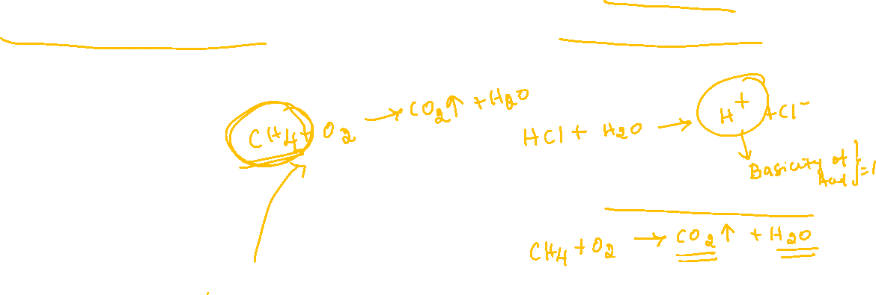
The properties of matter can be classified into two types
Physical properties
The properties which can be measured (or) observed without changing the identity (or) the composition of the substance are called physical properties
Ex : Colour, Odour, m.p., density
Chemical properties
The properties which can be measured (or) observed by a chemical change are called chemical properties
Ex : Basicity, Combustibility etc.,

Slide 12

Multiple Choice Question
1. Matter is nothing but…
a. Has Mass
b. Occupies some space
c. Both A and B
d. No correct definition

Slide 13
INTERNATIONAL SYSTEM OF UNITS

Slide 14
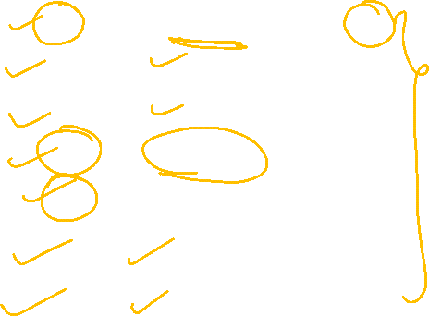
The International System of units (SI) :
Base physical quantities and their units
Base Physical
Quantity
Symbol for
Quantity
Name of SI
unit
Symbol
for SI Unit
Length
L
Meter
m
Mass
M
Kilogram
Kg
Time
T
Second
S
Electric current
I
Ampere
A
Temperature
t
Kelvin
K
Amount of substance
n
Mole
mol
Luminous intensity
I_{v}
Candela
cd

Slide 15

Multiple
Prefix
Symbol
10⁻²⁴
Yocto
Y
10⁻²¹
Zepto
Z
10⁻¹⁸
Atto
a
10⁻¹⁵
femto
f
10⁻¹²
Pico
P
10⁻⁹
Nano
n
10⁻⁶
Micro
𝛍
10⁻³
Milli
m

Slide 16
Multiple
Prefix
Symbol
10⁻²
Centi
c
10⁻¹
Deci
d
10
Deca
da
10²
Hecto
h
10³
Kilo
k
10⁶
Mega
M
10⁹
Giga
G
10¹²
Tera
T

Slide 17
Multiple
Prefix
Symbol
10¹⁵
Peta
P
10¹⁸
Exa
E
10²¹
Zeta
Z
10²⁴
Yotta
y

Slide 18

MASS, WEIGHT, VOLUME, DENSITY AND TEMPERATURE

Slide 19
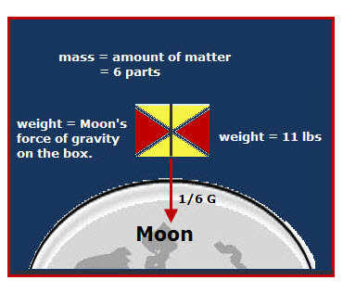
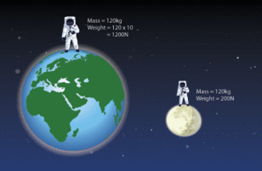
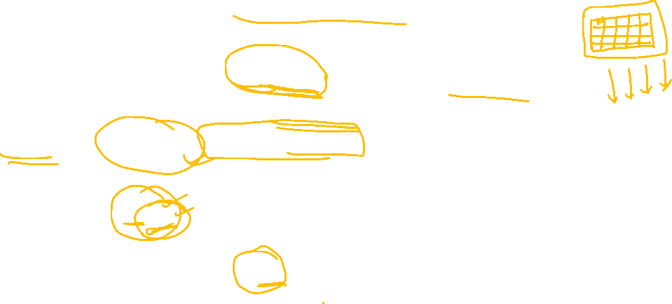
Mass and Weight
Mass of a substance is the amount of matter present in it.
Weight is the force exerted by gravity on an object.
The mass of a substance is constant whereas its weight may vary from one place to another due to change in gravity
The SI unit of mass is kg (1kg = 1000 g).

Slide 20
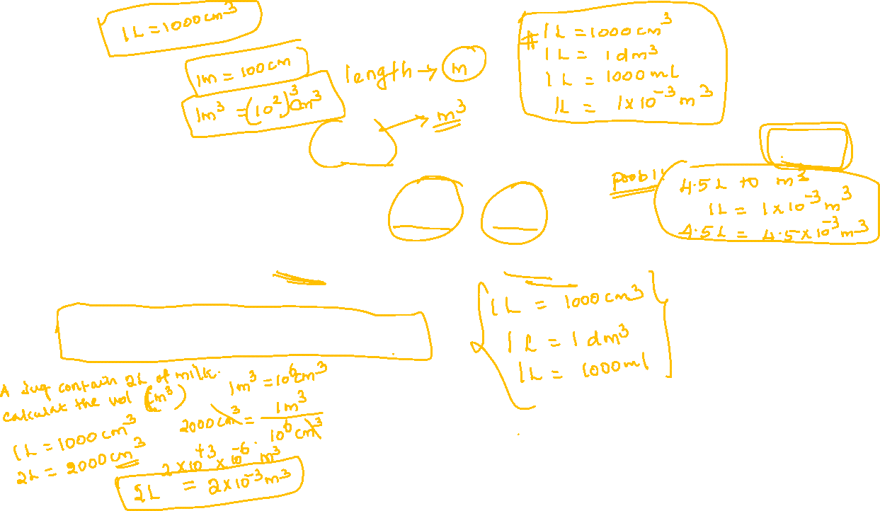
Volume:
Volume has the units of (length)³. So in SI system, volume has units of m³.
smaller volumes are denoted in cm³ or dm³ units.
A common unit, liter (L) which is not an SI unit, is used for measurement of volume of liquids.
1 L = 1 dm³ = 1000 ml = 1000cm³

Slide 21
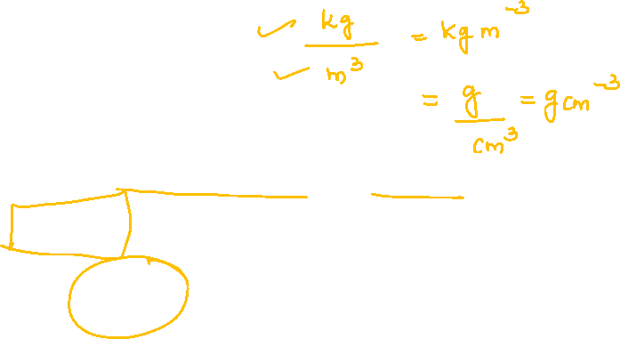
Density:
Mass
Density =
Volume
Density of a substance is its amount of mass per unit volume.
SI units of density
=
Kg m⁻³
Density is also expressed in gcm⁻³

Slide 22
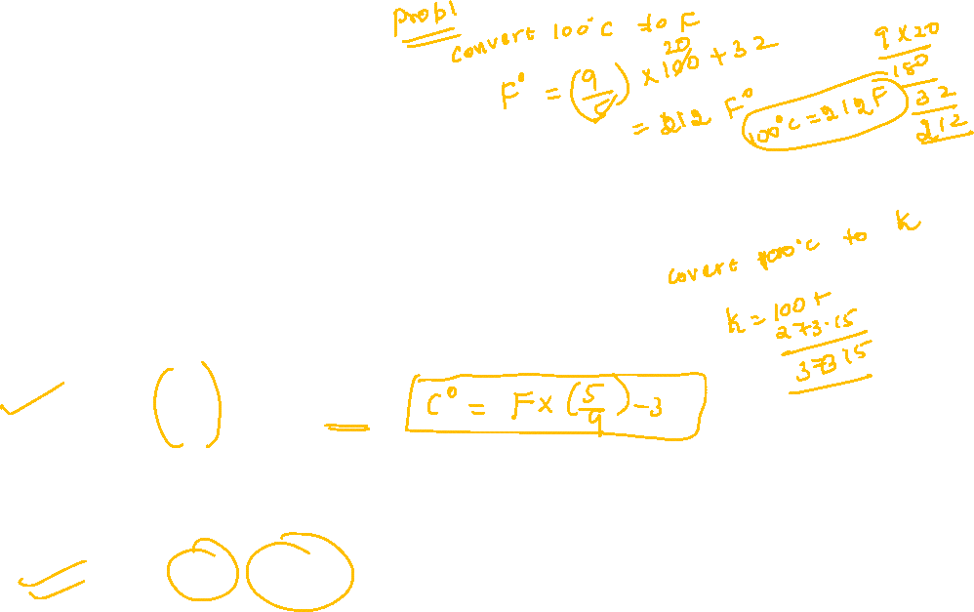
Temperature:
There are three common scales to measure temperatures
⁰c(degree Celsius),
⁰F (degree Fahrenheit).
K ( Kelvin)
⁰F is related to ⁰C as follows.
9
⁰F
=
( ⁰C)
+
32
5
The Kelvin scale is related to Celsius scale as follows:
K
=
⁰C
+
273.15

Slide 23
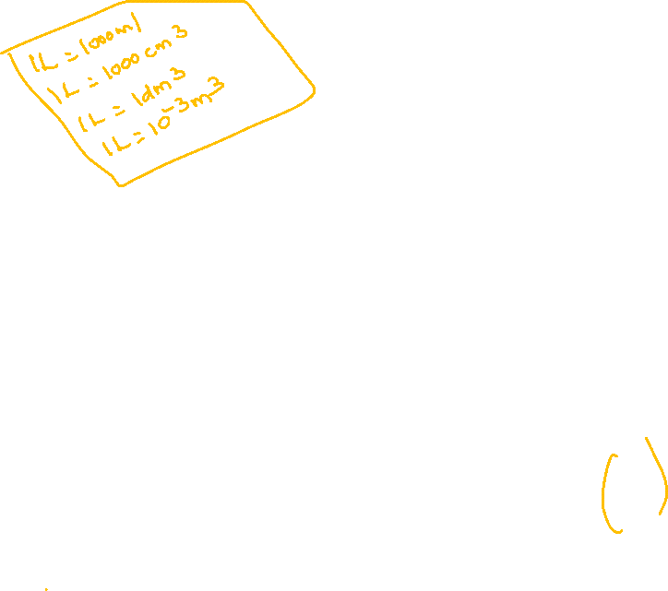
Multiple Choice Question
1. What is the unit for luminous intensity ?
a.
g
b.
mg
c.
cd
d.
All
2. 1L = ?
a.
1000 ml
b.
1000 cm³
c.
1 dm³
d.
All
3. Which is correct statement ?
5
9
a.
F
=
⁰C
+
32
b.
F
=
⁰C
+
32
9
5
9
5
c.
F
=
⁰C
+
23
d.
F
=
⁰C
+
23
5
9

Slide 24
SCIENTIFIC NOTATION

Slide 25
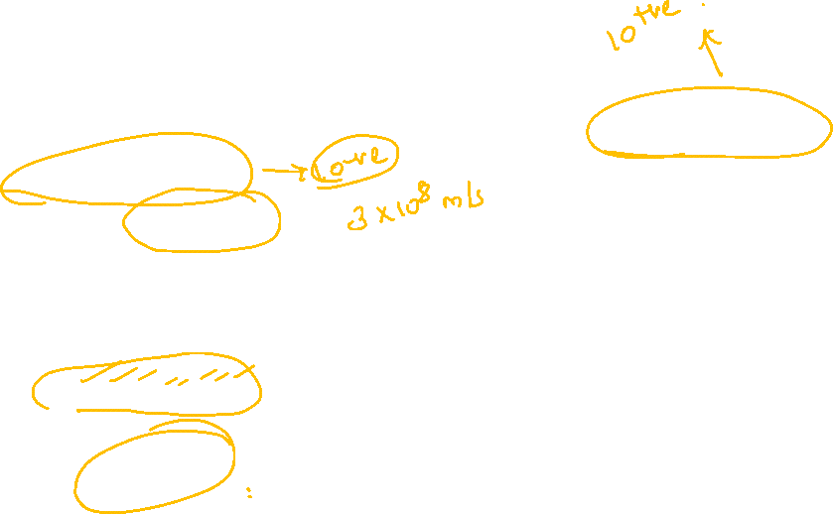
Scientific Notation:
Scientific notations are used when one has to deal with extremely large
numbers or smallest numbers.
Scientific notations.
=
N × 10^{n}
where N(digit term)
= varies between 1.000 & 9.999
n
=
Exponent having + or -
Eg: Speed of light is 30,00,00,000 ms⁻¹
=
3 × 10⁸ ms⁻¹
Scientific notations.

Slide 26
Uses of Scientific Notation:
Is used in the every mathematical conversions, like:
Addition
Subtraction
Multiplication
Division

Slide 27
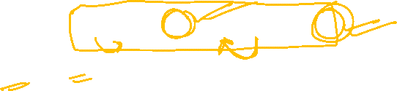
Addition & subtraction
Has two steps ,
Since we have to change
both the values to same
exponent
First the numbers are written in such a way that they have same
exponent.
The coefficients are added or subtracted as the case may be.
Example : addition of 6.625x10⁴ and 8.95x10³
⇒
6.25x10⁴ + 0.895x10⁴
=
7.545x10⁴

Slide 28

Since we have to change
both the values to same
exponent
Example :
Subtraction of
=
(2.5 × 10⁻² )
–
0.48 × 10⁻²
=
(2.5 – 0.48 )
×
10⁻²
=
2.02 × 10⁻²

Slide 29
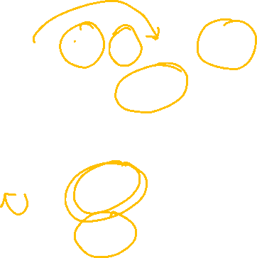
Multiplication and division:
These two operations follow the same rules which are there for exponential numbers.
Eg :
(5.6 × 10⁵)
×
(6.9 × 10⁸)
=
(5.6) (6.9) × 10⁵⁺⁸
=
(5.6 × 6.9) × 10¹³
=
38.64 × 10¹³
=
3.864 × 10¹⁴

Slide 30
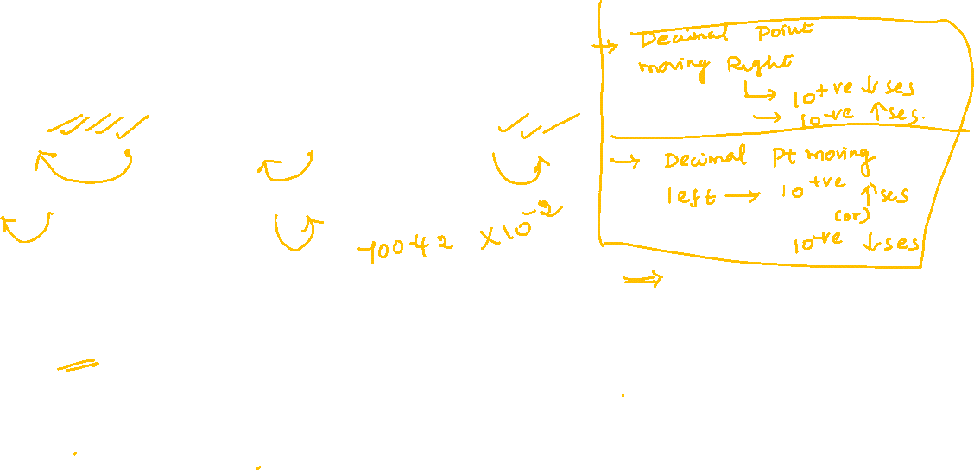
Example-1:
Express the following in the scientific notation
1,86,000
ii) 4007
(iii) 0.0068
iv) 700.0
(v) 7.0042.
Sol:
i) 1.86×10⁵
ii) 4.007×10³
iii) 6.8×10⁻³
iv) 7×10²
v) 7.0042

Slide 31
SIGNIFICANT FIGURES

Slide 32
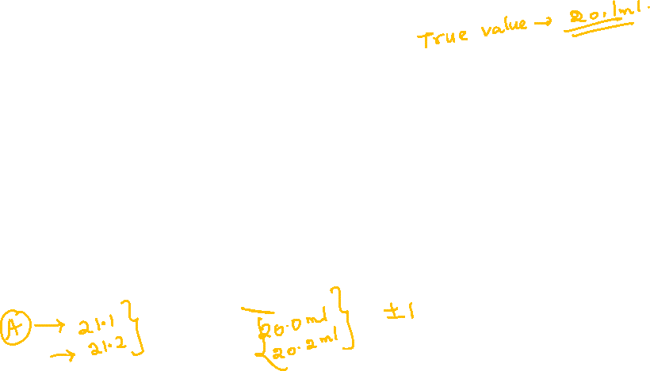
Significant Figures:
Significant figures are meaningful digits which are known with certainty.
In general experimental measurements
Near value
Exact value
Precise
Accurate

Slide 33
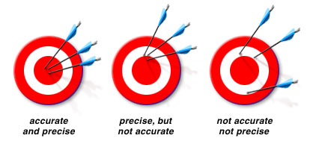

Importance of significant figures :
The uncertainity in the experimental or calculated values are indicated
by significant figures.
Example : Animation of practical room.

Slide 34
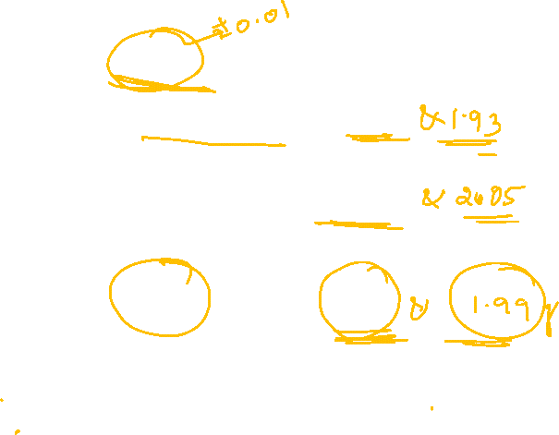
Example :
From these three which
is accurate and precise
If the true value = 2.00gm
Measured value by ‘A’ student = 1.95
and 1.93gms
Measured value by ‘B’ student = 1.94
and 2.05gms
Measured value by ‘C’ student = 2.01
and 1.99grms
Ans.
student ‘C

Slide 35
RULES FOR DETERMINING THE NUMBER OF SIGNIFICANT FIGURES

Slide 36
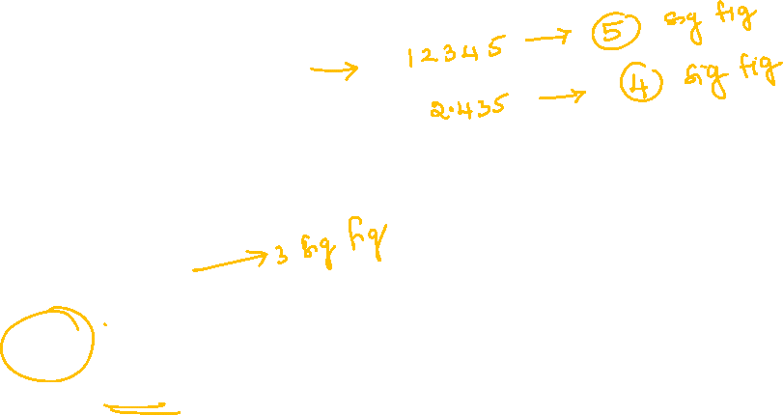
Rules for determining the number of significant figures
All non-zero digits are significant
Example: In
285 cm, there
are three
significant figures

Slide 37
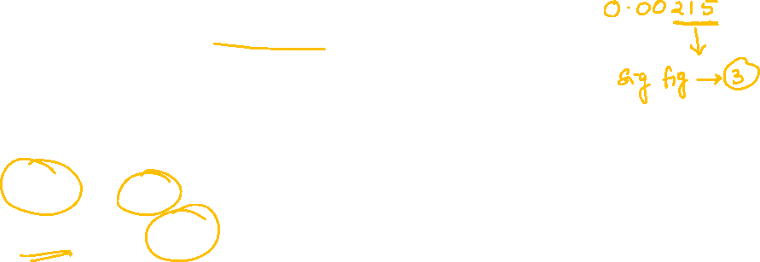
Zeros preceding to first non-zero
digit are not significant.
Eg : 0.03 has one significant figure and
0.0052 has two significant figures.

Slide 38
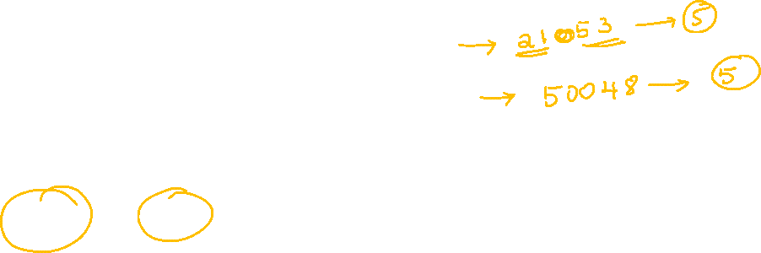
Eg : Zeros between two non-zero
digits are significant.
Eg :2.005 has four
significant figures.

Slide 39
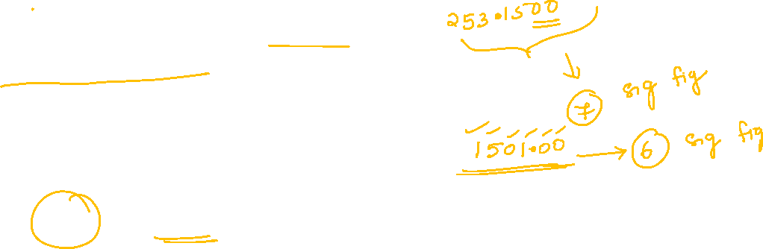
Zeros at the end or right of a number
are significant provided they are on the
right side of the decimal point.
Eg: 0.200 g has three
significant figures.

Slide 40
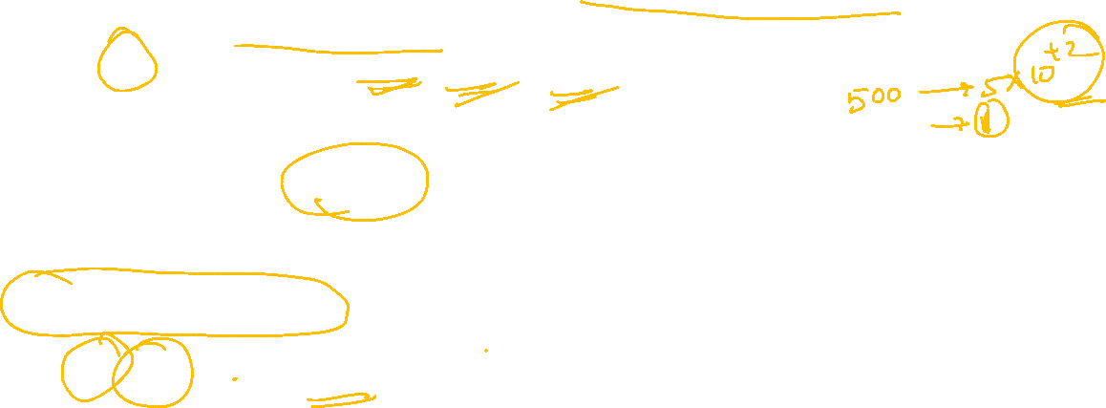
If a number ends in zeros that are not to the right of a decimal, the
zeros may or may not be significant.
Exponentials are not significant
Eg : 1500g may have two, three or four significant
figures.
This confusion can be significant by expressing the number in scientific
notation, N×10^{n}.(15×10²)
Where N has significant fig.
10^{n} is not significant.
∴ 15×10² has only two significant figure.

Slide 41
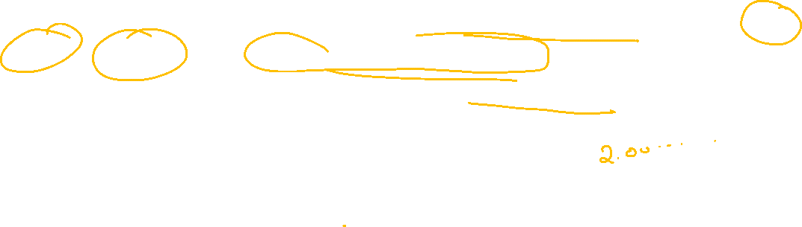
Lastly it may be emphasized that exact integral numbers, such as 2
balls or 20 eggs have infinite significant figures, can be represented by
writing infinite number of zeros after placing a decimal i.e..,
2 = 2.000000……… (or) 20 = 20.00000…..

Slide 42
ADDITION AND SUBTRACTION OF SIGNIFICANT FIGURES

Slide 43
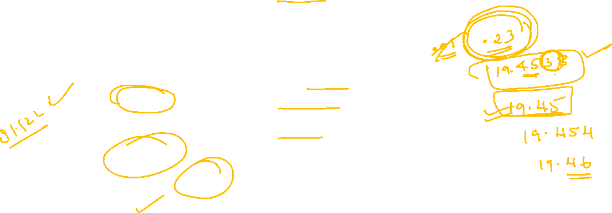
Addition and subtraction of Significant figures:
The result cannot have more digits to the right of the decimal point
than that at original number which has the least number of digits to
the right of the decimal point in it.
Eg :
12.11
18.0 has only one digit after the decimal point
18.0
01.012
31.122
Therefore Answer is 31.1

Slide 44

Multiplication and division of significant Figures:
In these operations, the result must be reported with no more
significant figures as are there in the measurement with the few
significant figures.
Eg :
=
2.5 × 1.25
=
3.125
Since 2.5 has two significant figures,
the result should not have more than
two significant figures.
3.1 is the answer

Slide 45
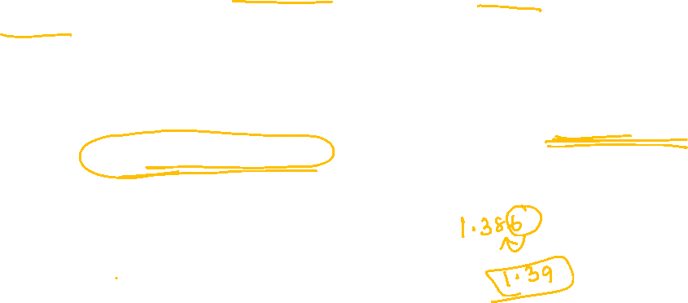
Rules in rounding the numbers
The digit on the extreme right (i.e., the last digit) of a number may be
removed.
If the rightmost digit to be removed is more than 5, the preceding number is increased by one.
For example, 1.386
⇒
1.39

Slide 46
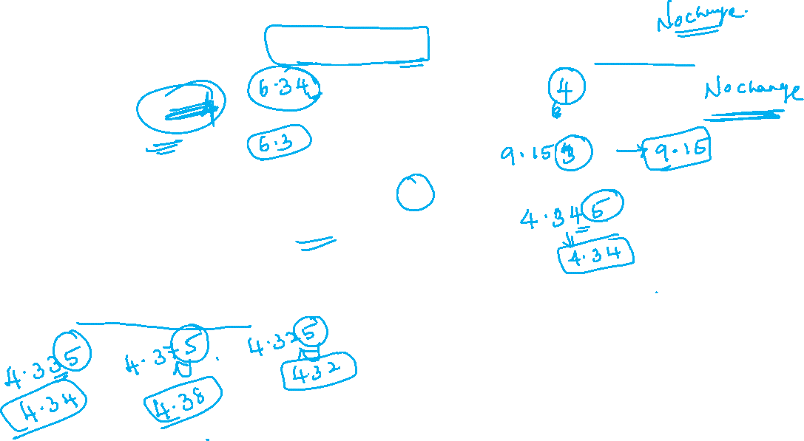
If the digit to be removed is less than 5, the preceding number is not
changed.
For example, if 6.35 is to be rounded by removing 5, we have to increase rounded off to 6.2 only.
For example,4.334
⇒
4.33
If the digit to be removed is 5, then the preceding number is not changed if it is an even number but it is increased by one if it is an odd number.
For example,6.35
⇒
6.4

Slide 47

Example 1:
Express the following in the scientific notation
(i) 5.607892
(ii) 32.392800
Ans:
The fifth digit 8 is
greater than 5
(i) 5.608
(ii) 32.39
The digit 2 is dropped
and since it is
less than 5

Slide 48
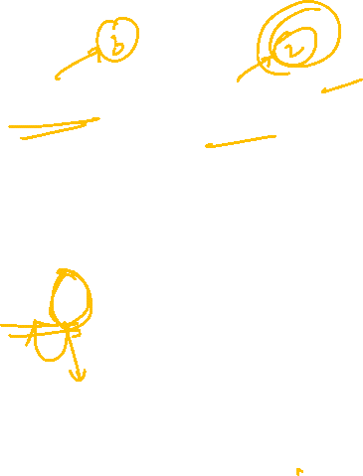
Example 2:
What is the sum of 2.368kg and 1.02 kg?
The sum is rounded off to 2 decimal places
Sol:
2.368 kg
1.02 kg
+
3.388 kg
Therefore, the sum is 3.39kg.

Slide 49

DIMENSIONAL ANALYSIS

Slide 50
Dimensional Analysis:
Often while calculating, there is a need to convert units from one system
to other.
The method used to accomplish this is called factor label method
or
unit factor method or dimensional analysis.

Slide 51
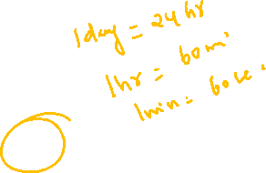
Example:
How many seconds are there in 2 days?
Sol:
Here, we know 1day
=
24 hours(h)
Then 1h
=
60min
1 min
=
60 sec
∴ Converting 2days to seconds, the unit factors can be multiplied in series in one step only as follows:
2 days
×
24h
×
60 min
×
60 sec
=
2
×
24
×
60
×
60s
=
172800 s

Slide 52
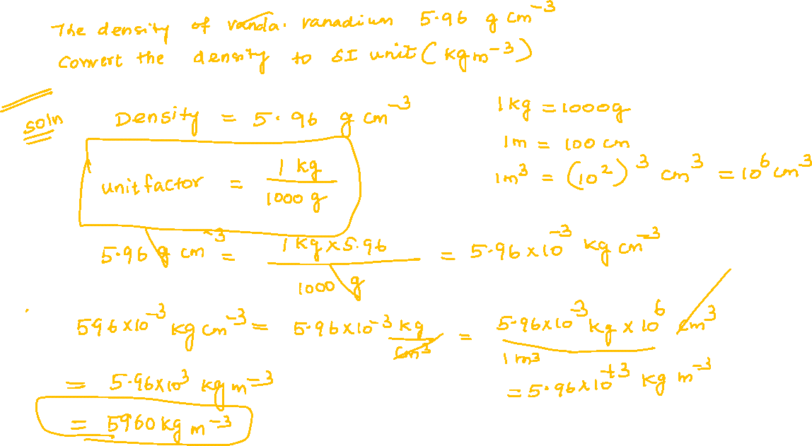

Slide 53
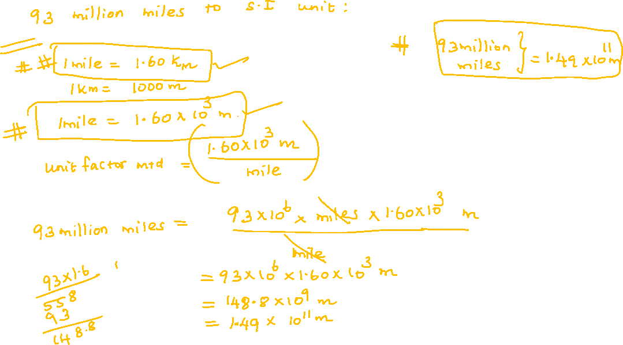

Slide 54
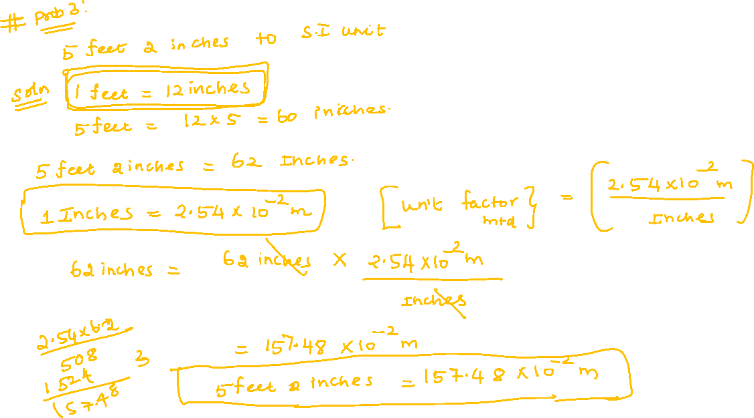

Slide 55
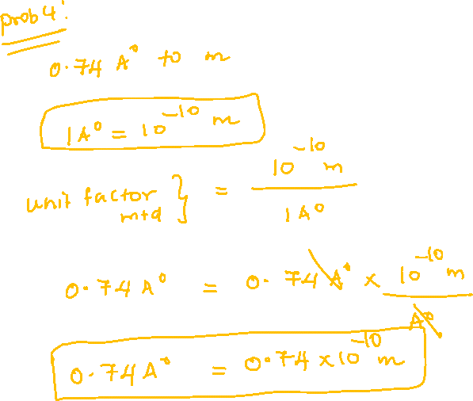

Slide 56
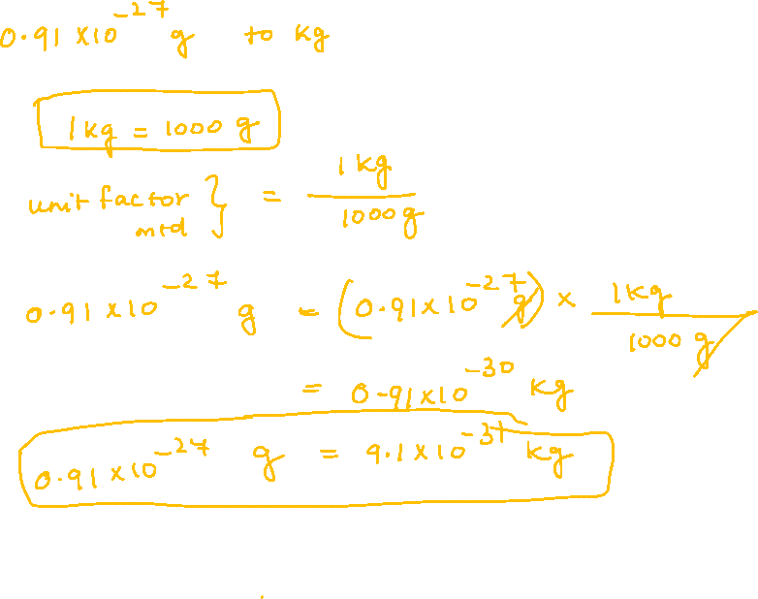

Slide 57
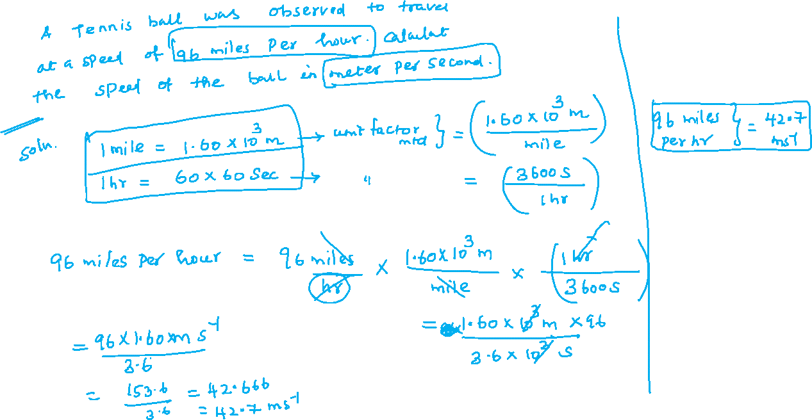

Slide 58
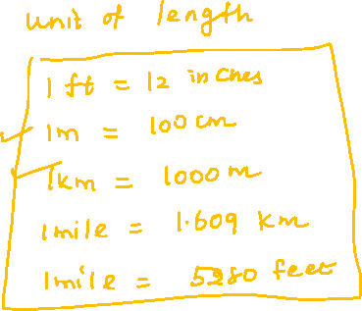

Slide 59
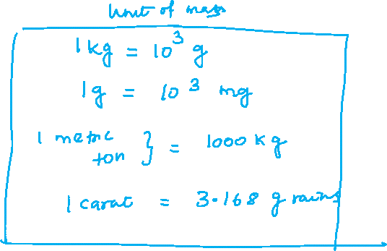

Slide 60
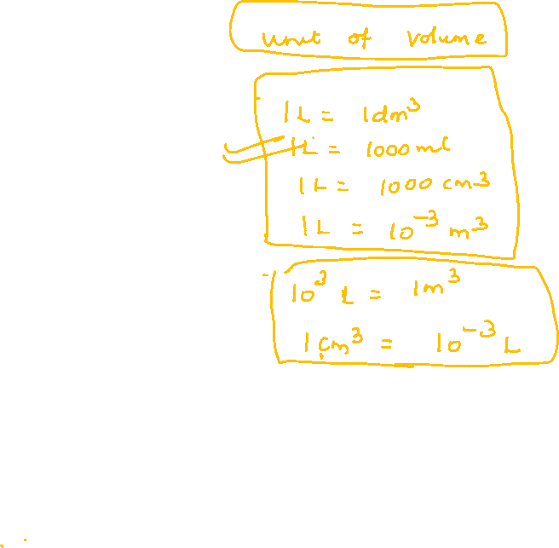
Thank you…

